Slide 1


Slide 2
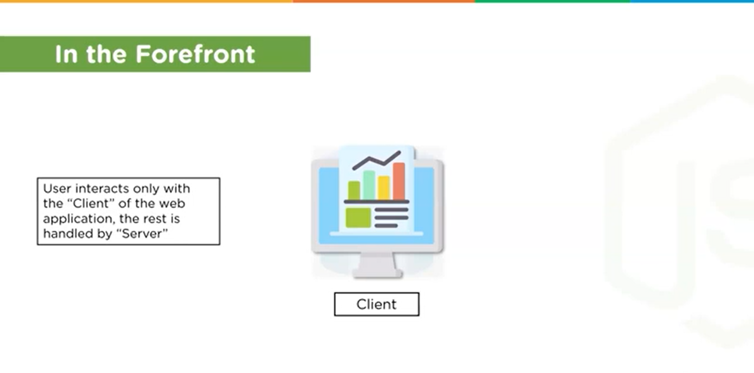

Slide 3
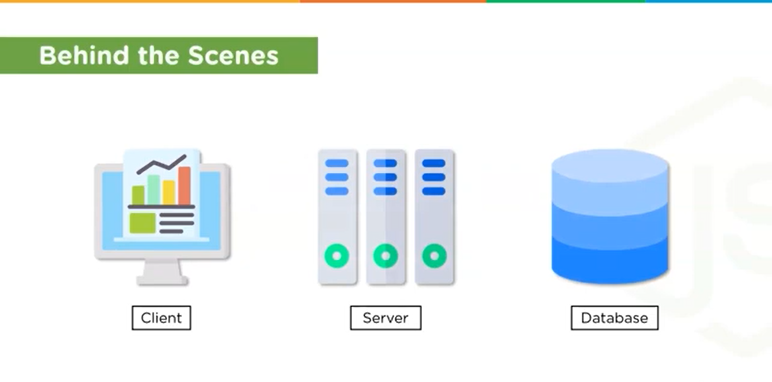

Slide 4
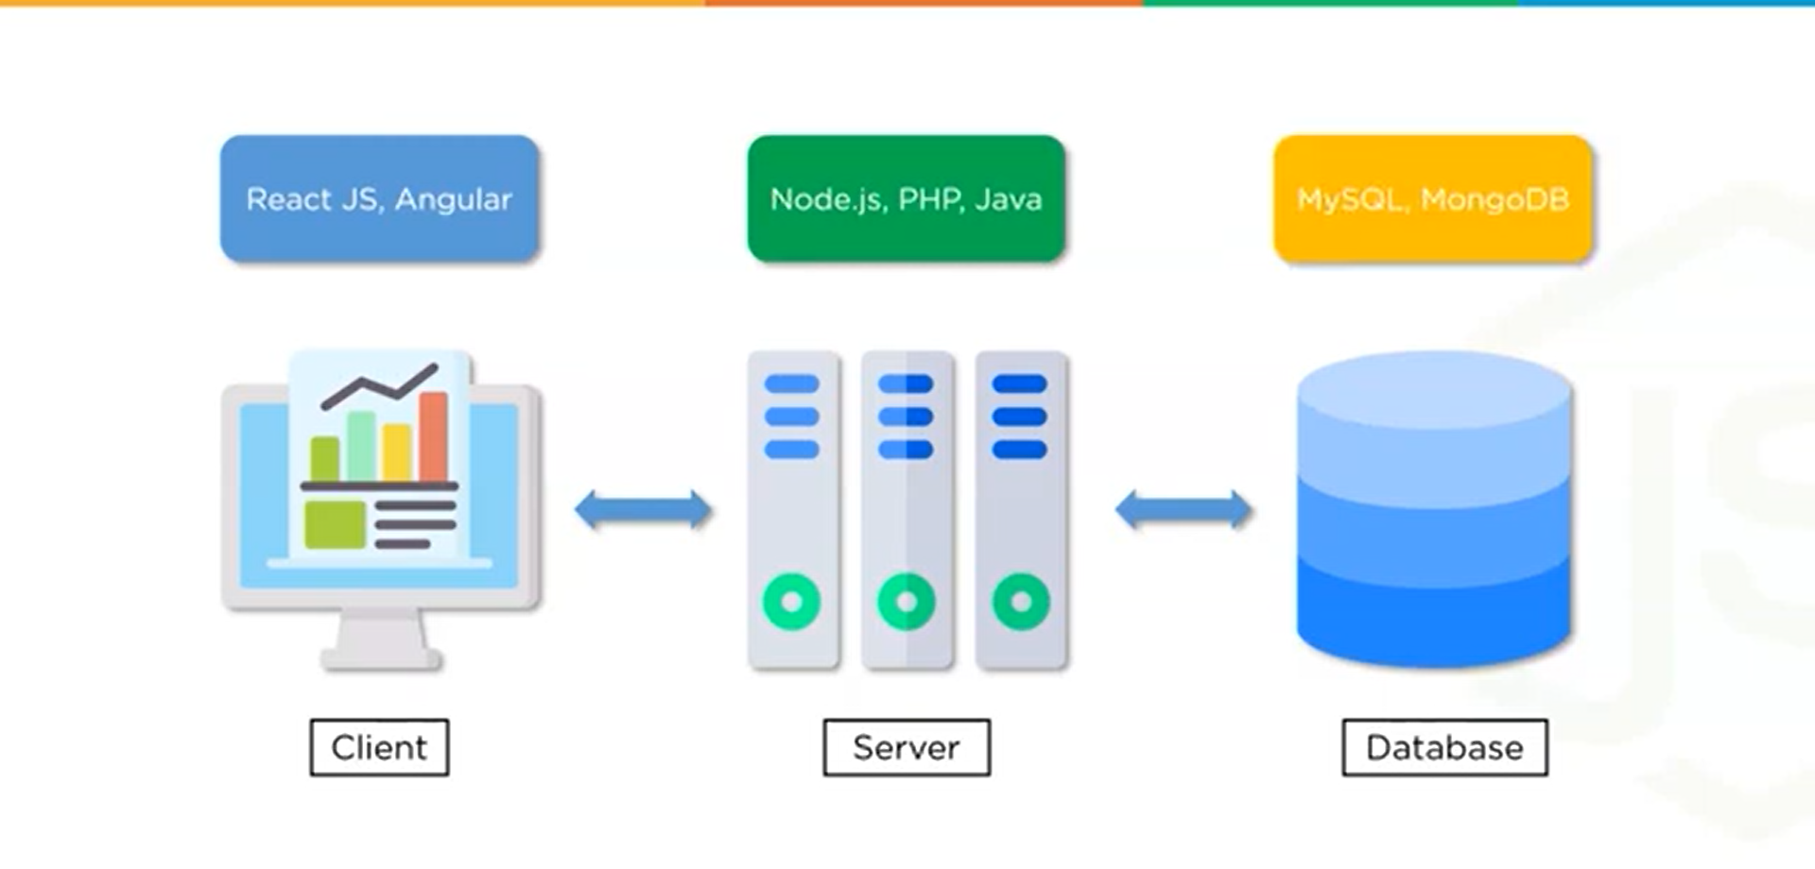

Slide 5
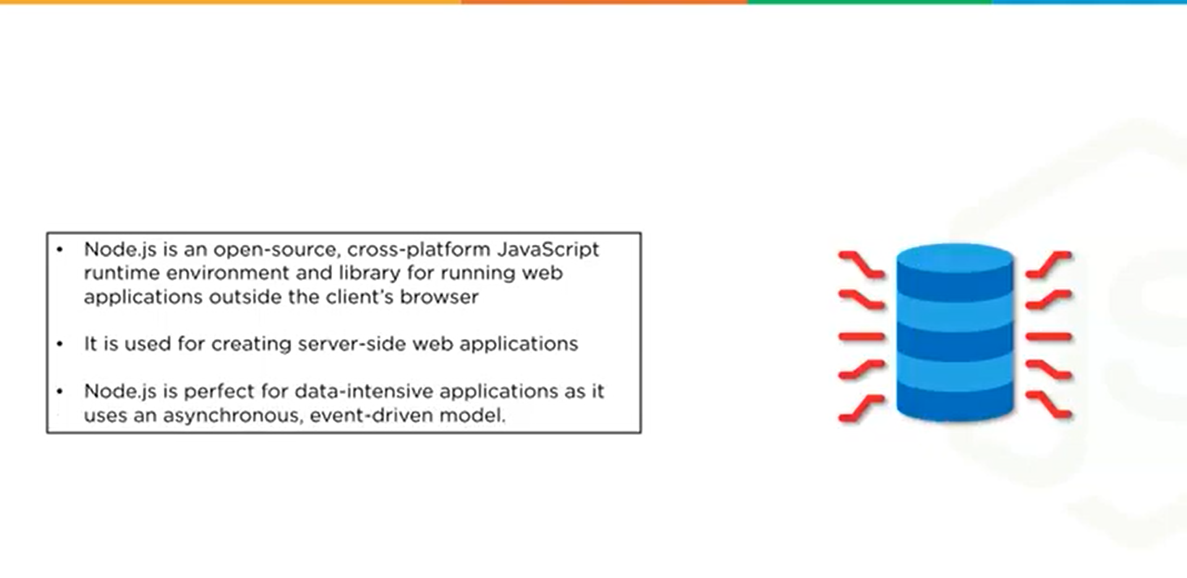

Slide 6
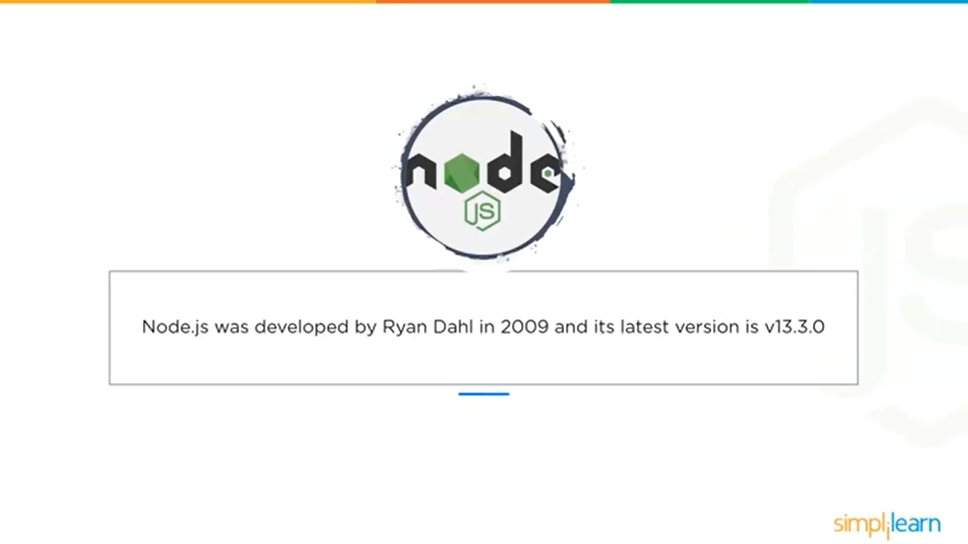

Slide 7
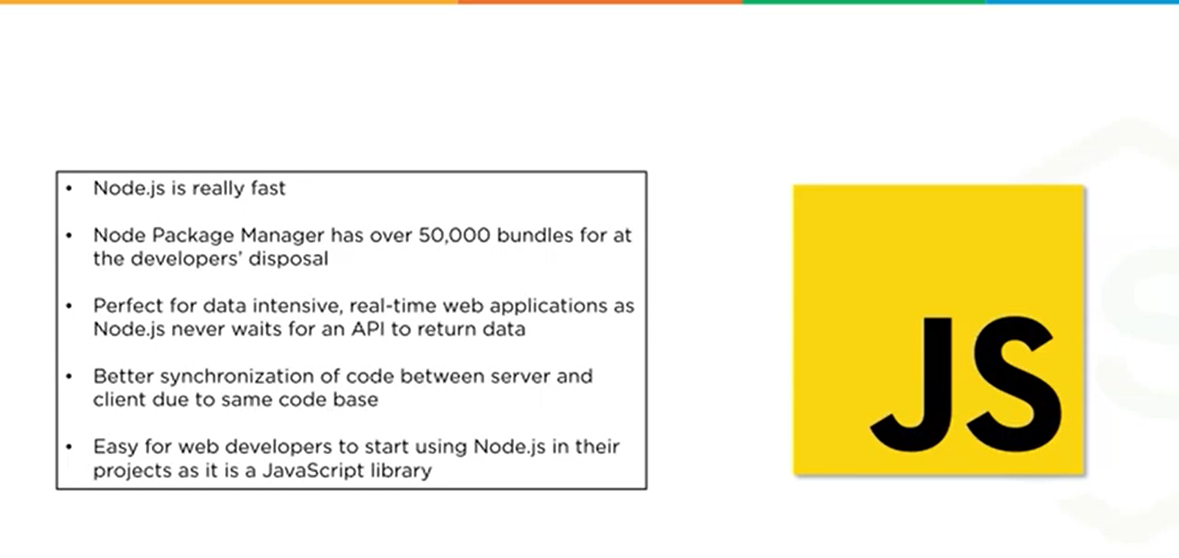

Slide 8
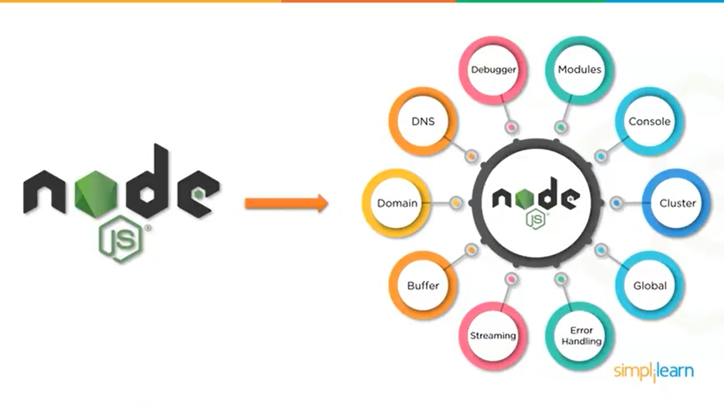

Slide 9


Slide 10
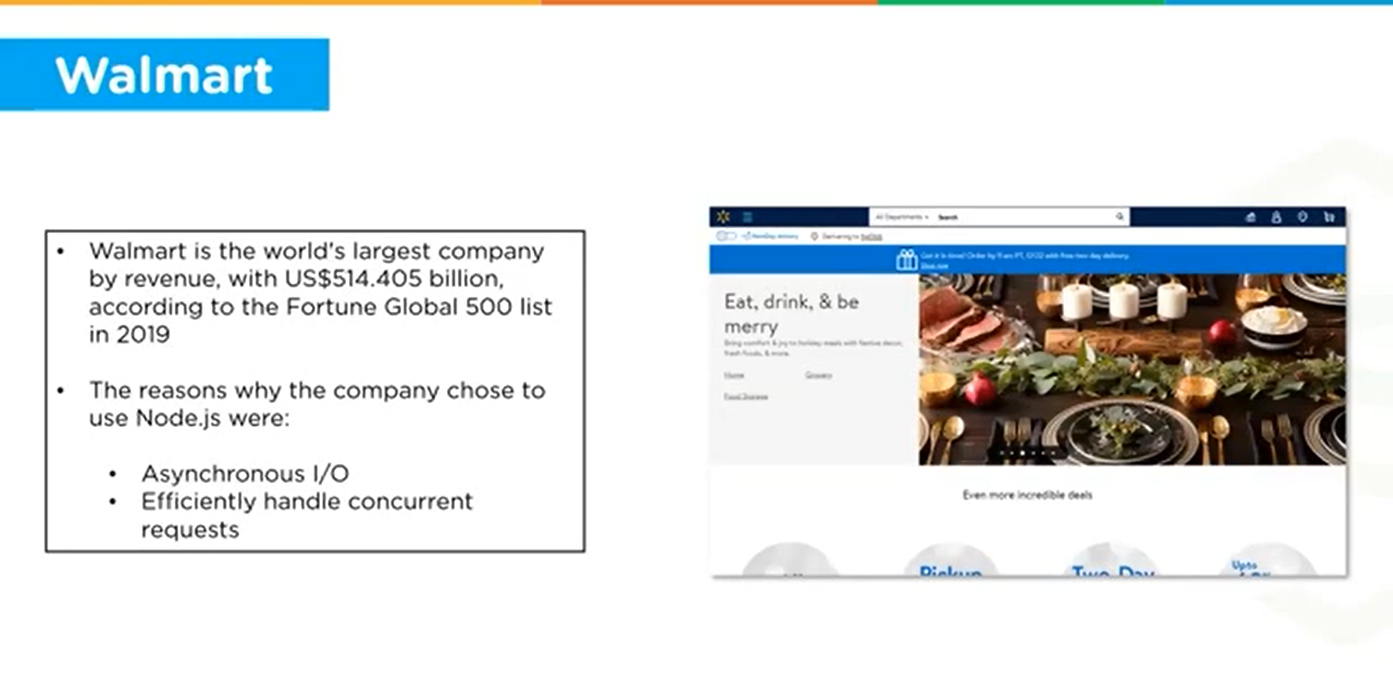

Slide 11
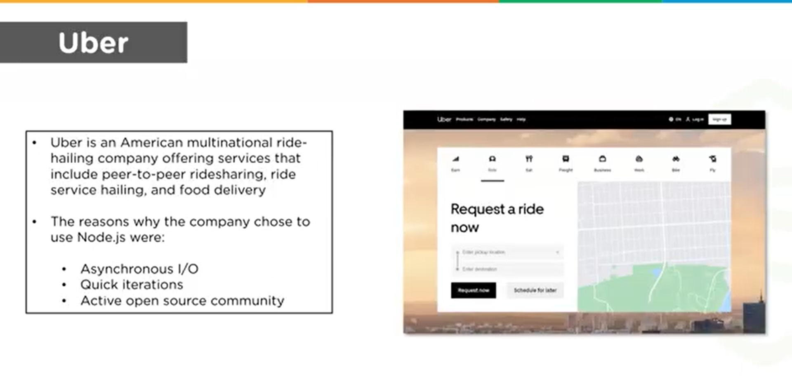

Slide 12


Slide 13
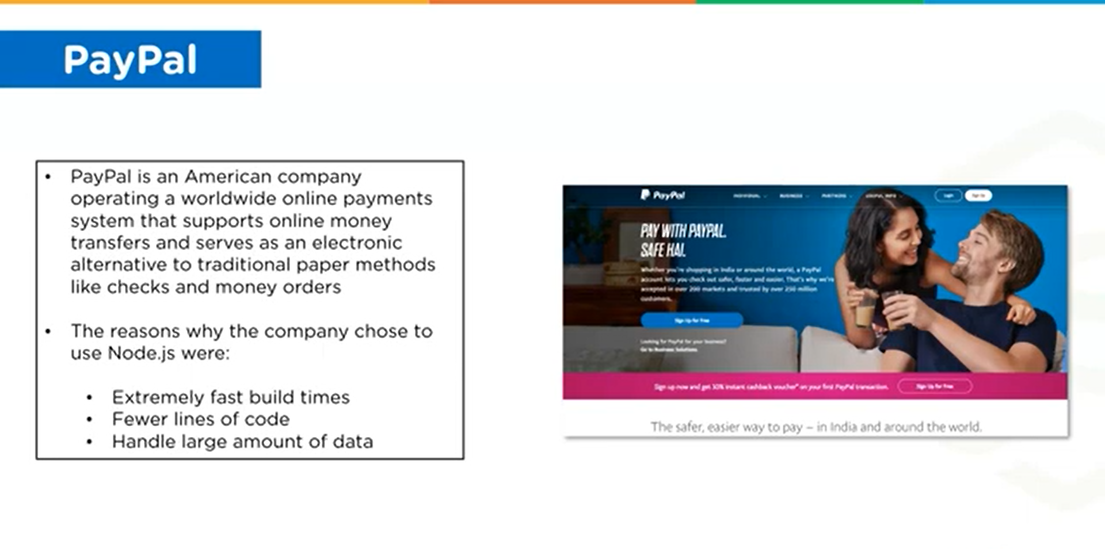

Slide 14
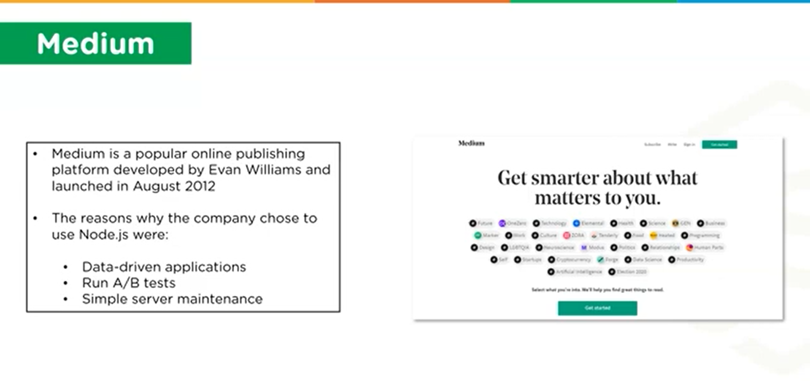

Slide 15


Slide 16
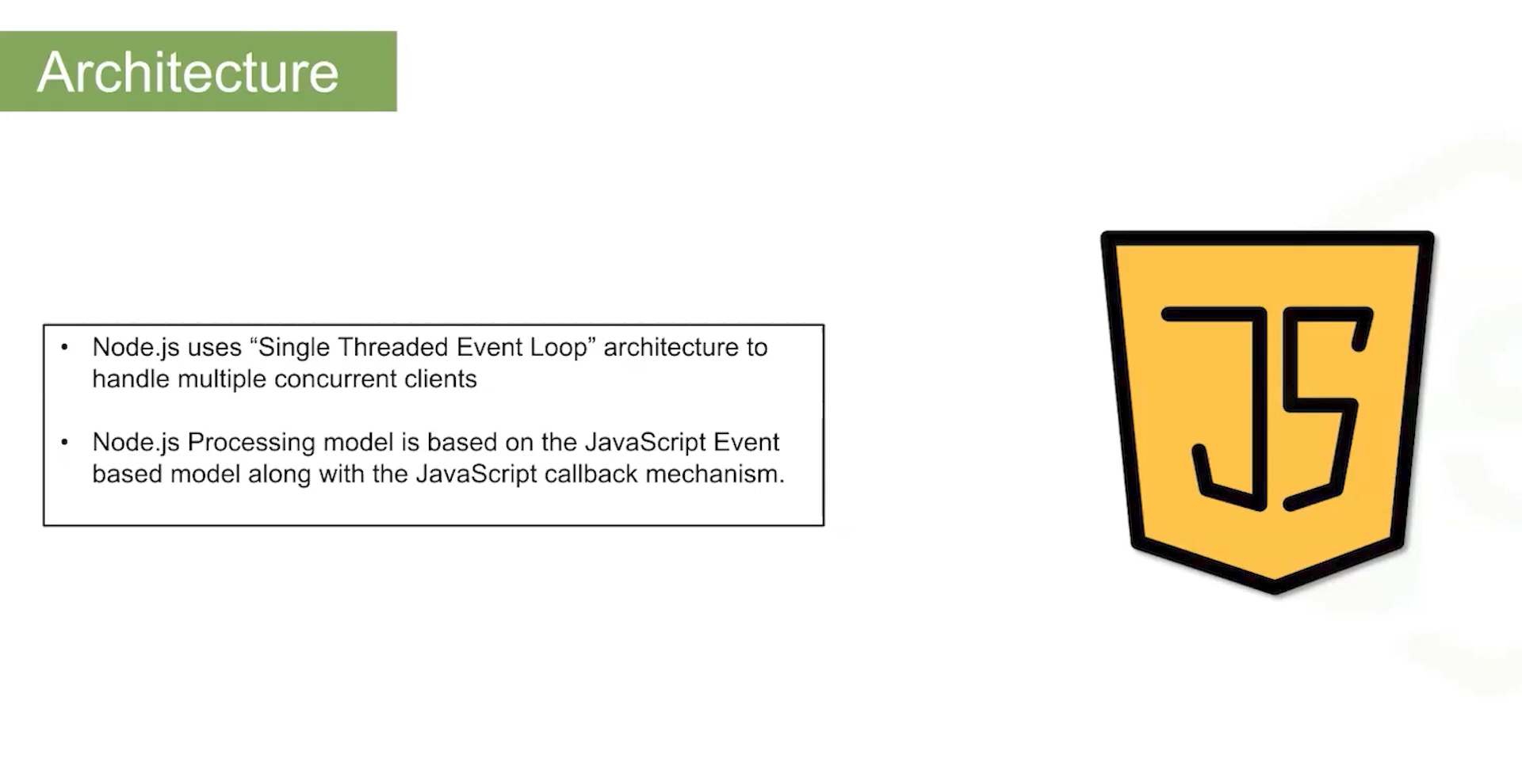

Slide 17
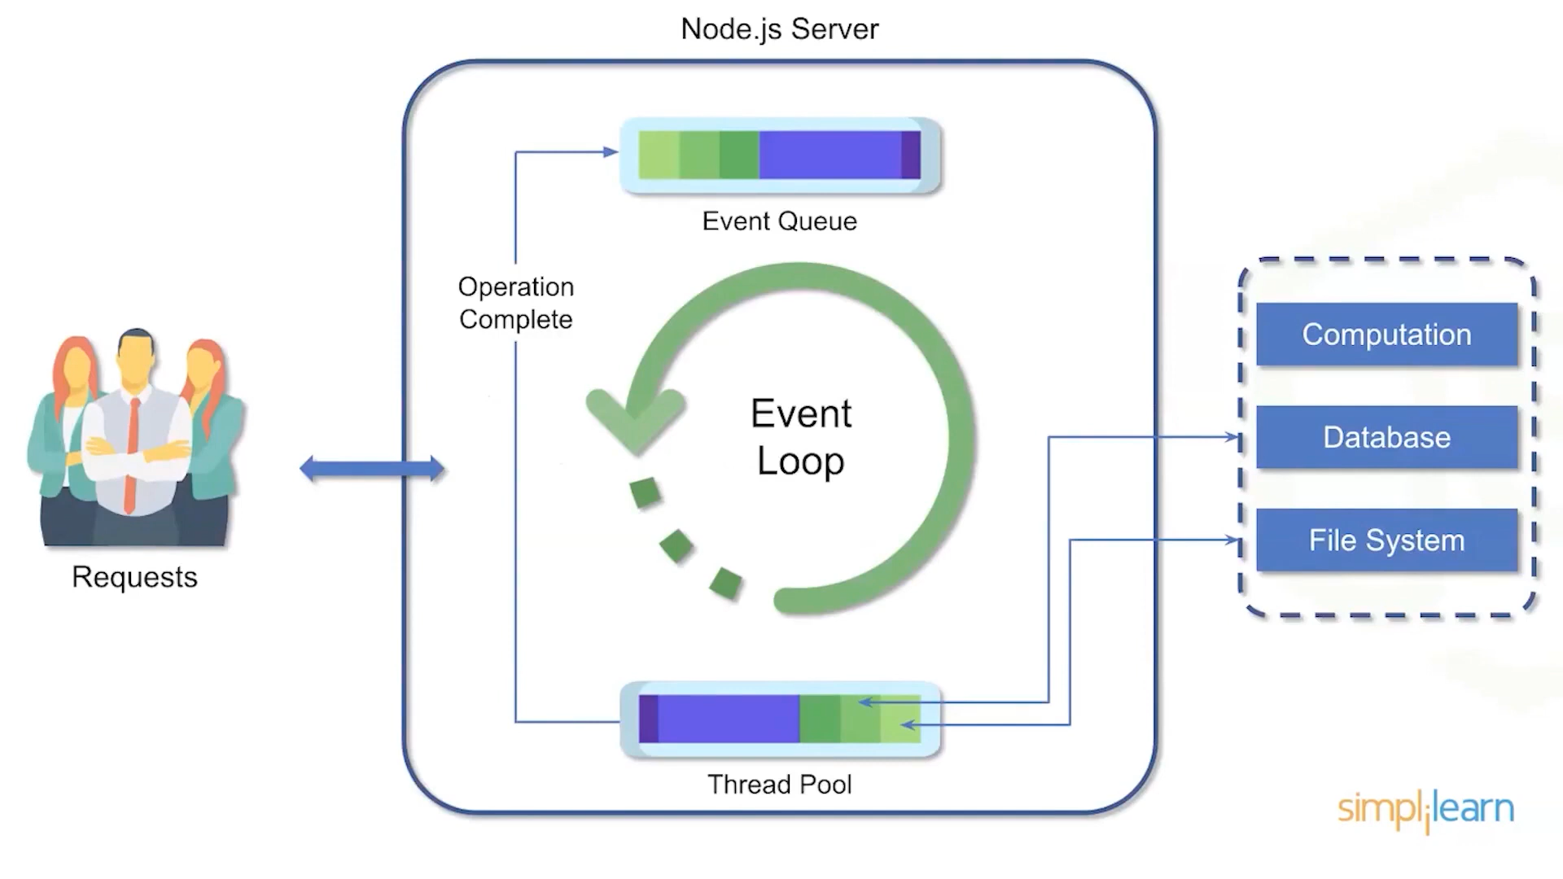

Slide 18


Slide 19
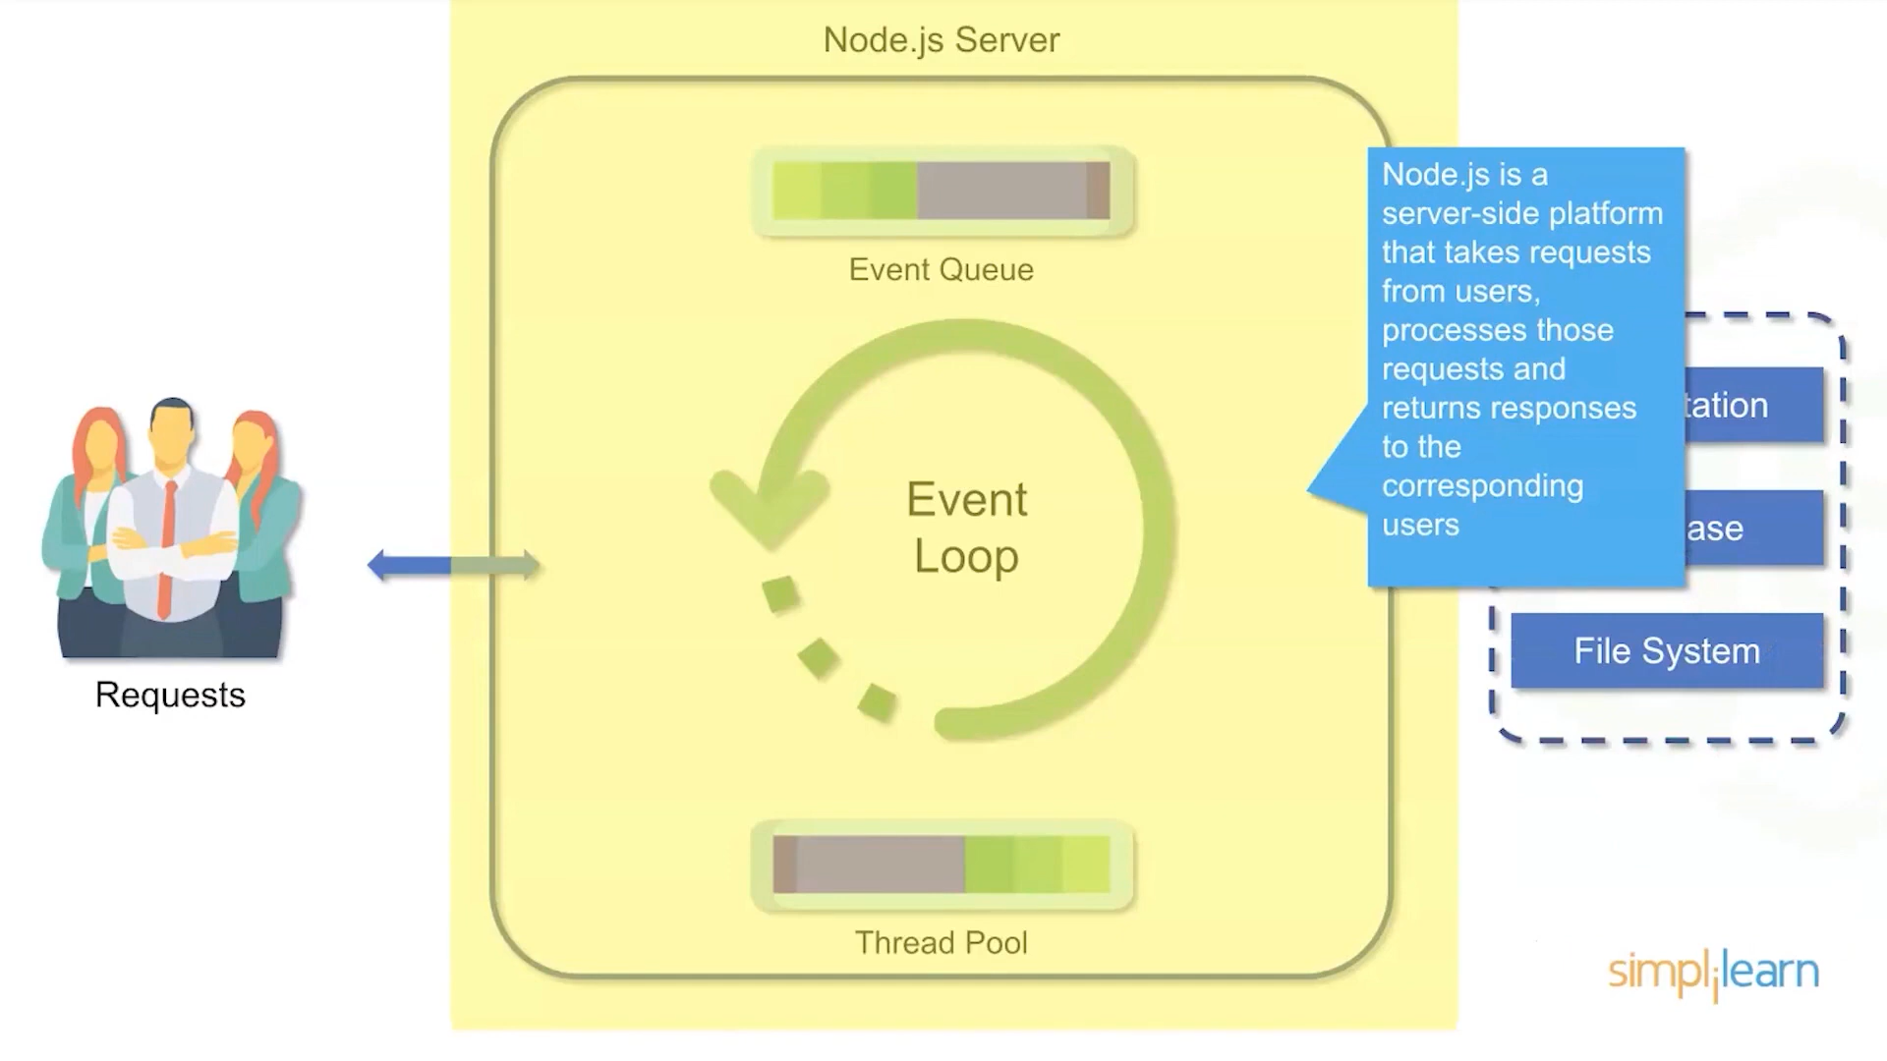

Slide 20
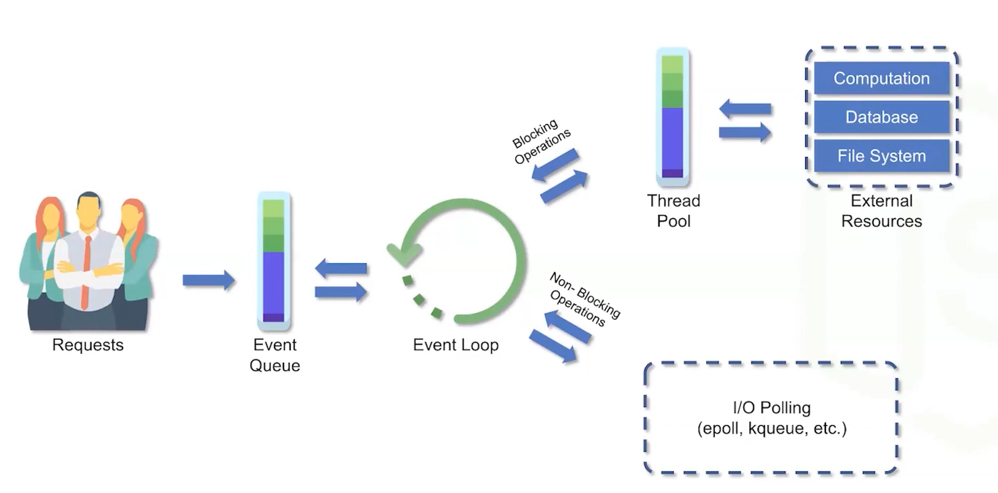

Slide 21
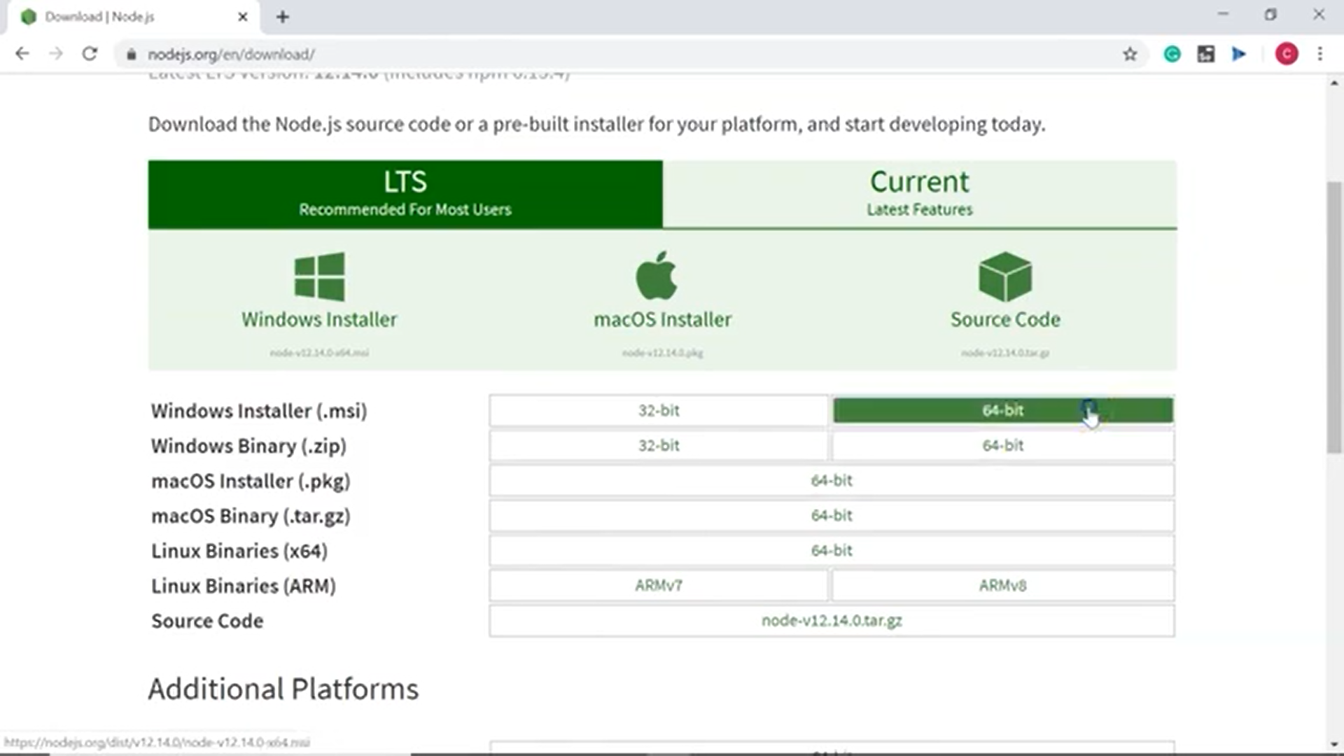

Slide 22


Slide 23
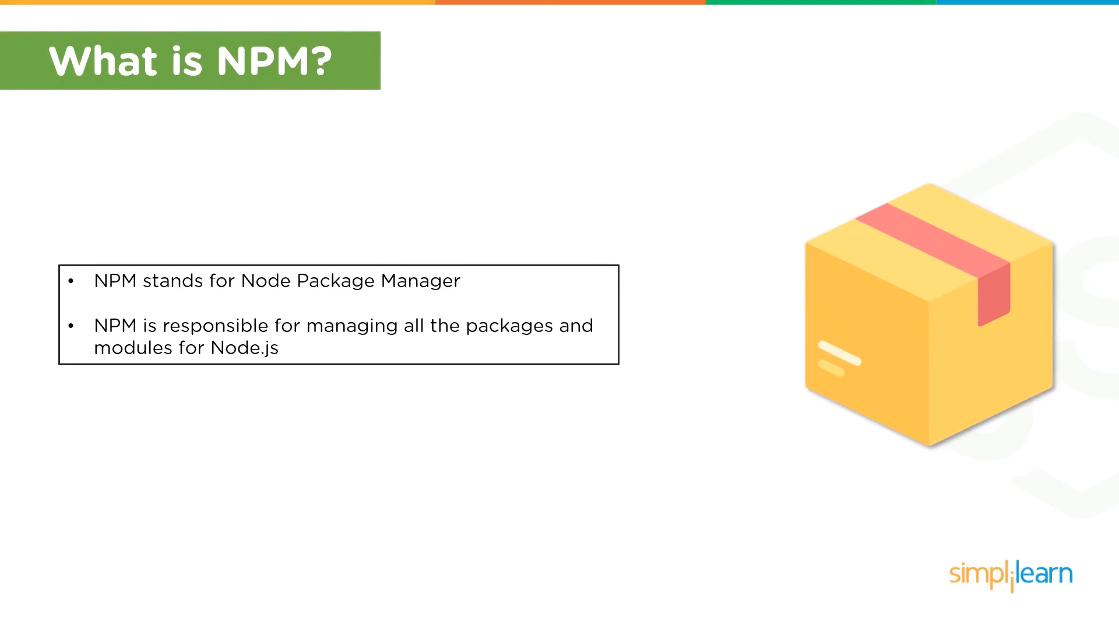
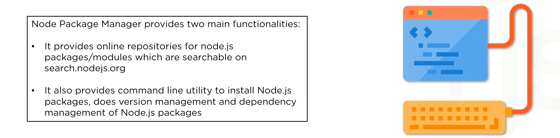

Slide 24
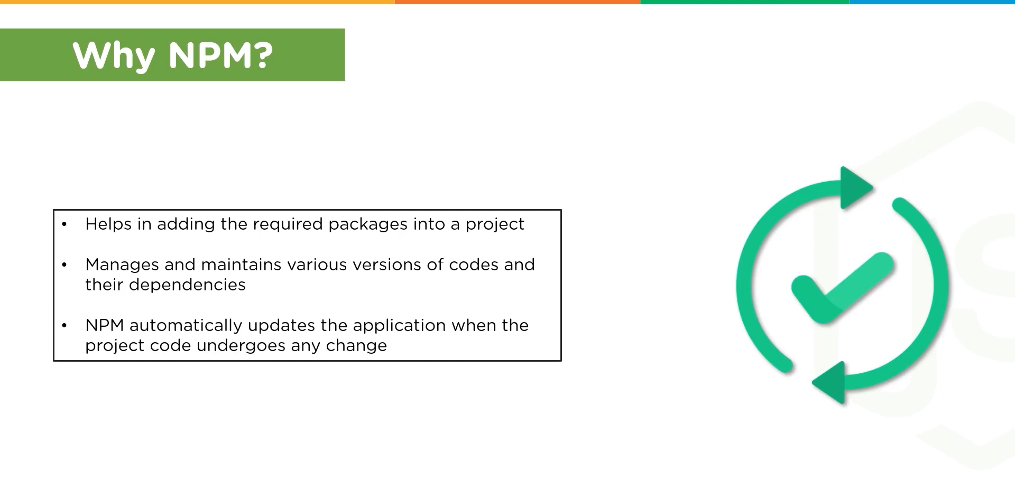

Slide 25


Slide 26
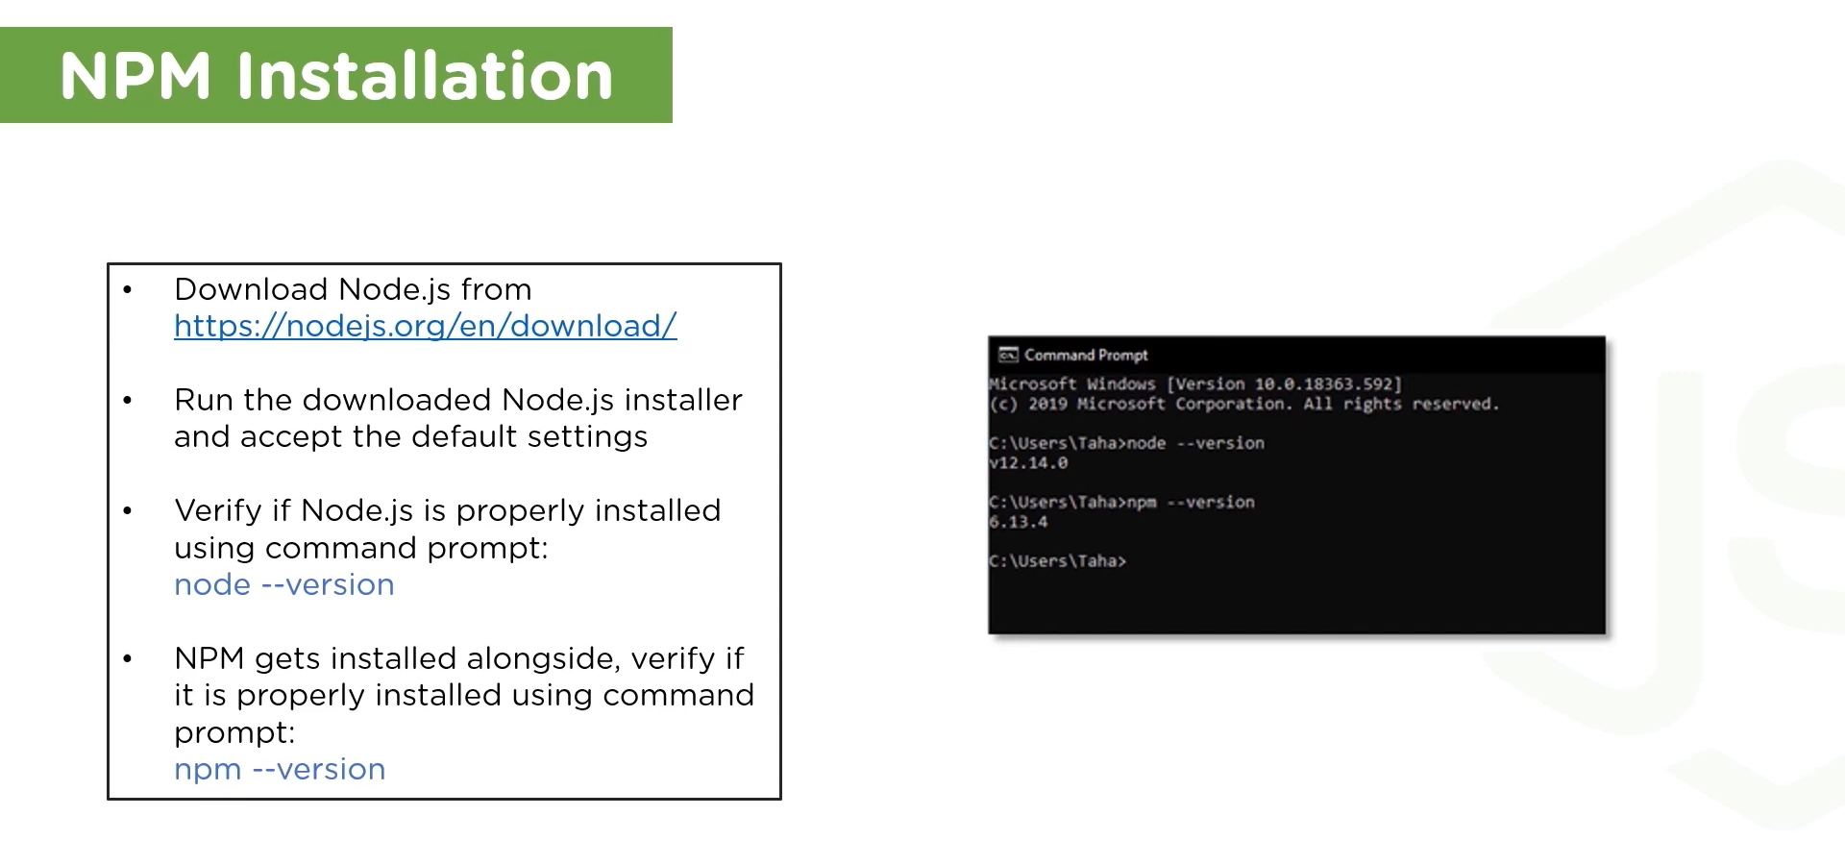

Slide 27
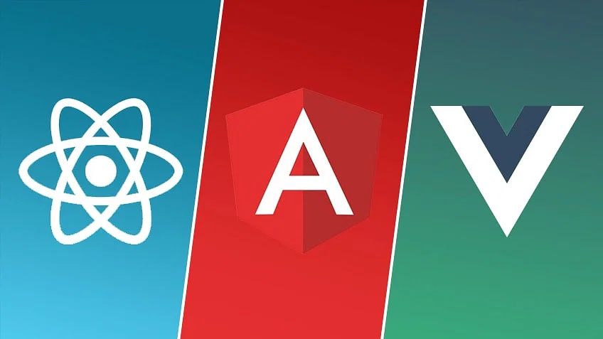

Slide 28
Table of Contents
Features
Use Cases
Performance
Data Binding
Scripting Language
Testing
Community Support
Growth Curve

Slide 29
Features
React
Angular
Vue
An open-source, front-end library developed by Facebook
Used for creating web and mobile applications.
it’s only the view layer and not a complete architecture.
React is very flexible and can be connected with several packages that have been developed for it, which helps in the development of a complete application.
an open-source, front-end framework developed by Google
Used for creating web applications.
MVC Architecture
The advantage here is that you don’t need to go through packages and then select from those.
An open-source, front-end library developed by Evan You, an ex-Google employee.
Vue is used for creating web applications
The packages developed for Vue are lesser than that of React due to its lower popularity, which makes it a challenge to select packages that provide functionality relevant to a particular scenario.

Slide 30
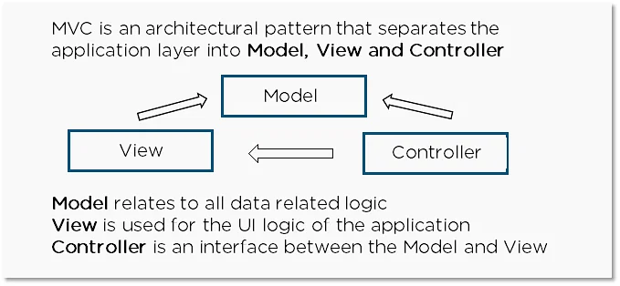

Slide 31

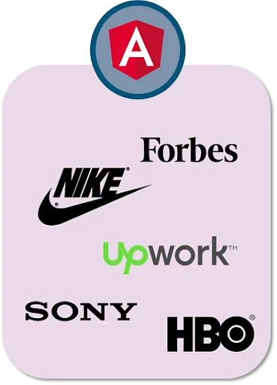
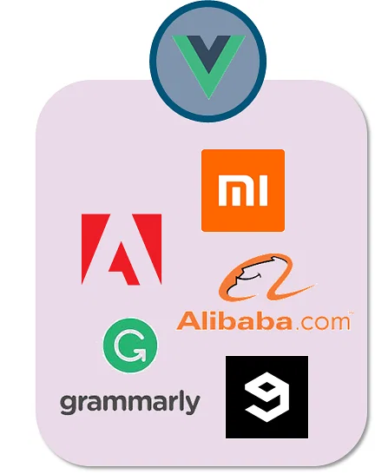
Use Cases
React
Angular
Vue
Initially released in March 2013 and is extensively used by Facebook
Angular is a TypeScript-based JavaScript framework and was initially released in October 2010.
Initially released in February 2014 by ex-Google employee Evan You.

Slide 32
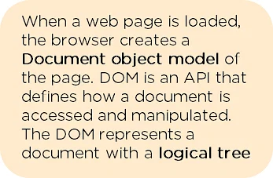
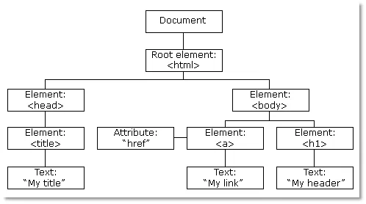
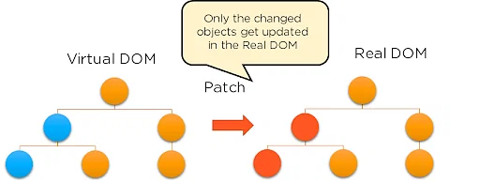
Performances
React
Angular
Vue
Virtual DOM
Real DOM
Virtual DOM

Slide 33
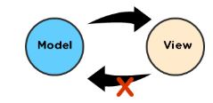
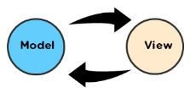
Data Binding “Data binding is a process that allows an internet user to manipulate Web page elements using a Web browser. It is used in Web pages that contain interactive components such as forms, calculators, tutorials, and games.”
React
Angular
Vue
One Way Binding
Two Way Binding
Both one-way binding and two-way binding, which is called reactive two-way data binding. It automatically selects the correct way to update the elements based on the type of input.

Slide 34
Scripting Language
React
Angular
Vue
React makes use of a component, which contains both the markup (UI) and logic in the same file.
React only requires the knowledge of JavaScript.
Angular uses TypeScript. TypeScript is a statically typed language, which means you must define the variable’s type (string, character, number, array, etc.).
VueJS uses HTML, js, and CSS separately. The template-based approach for VueJS is straightforward, and new developers can easily adapt to this programming style promoted by Vue.

Slide 35
Testing
React
Angular
Vue
Jest is used by Facebook to run tests on React, is embedded in every React library, and requires zero configuration.
Angular uses Jasmine to run various tests. The Jasmine framework allows various functionalities to write different kinds of tests cases.
Vue CLI has built-in options for unit testing with Jest or Mocha. Vue’s single-file components make it straightforward to write unit tests for components in isolation.

Slide 36
Community Support
React
Angular
Vue
Massive number of GitHub repositories attributed to it.
At the time of this writing, there are 1 million repositories, more than 5 million commits, and over 1 million issues posted on GitHub.
A few popular Github repositories on React are reactjs101, reactjs.org, reason-react, react-paginate.
Relatively large following on GitHub with over 556K repositories, 1 million commits, and 570K issues posted on GitHub.
Angular, angular.js, angular-cli, angular-seed are a few Github repositories.
About 308k repositories, 812K commits, and over 302K issues posted on GitHub.
Vue-awesome-swiper, vuejs.org, vue-Apollo are a few Vue GitHub repositories that have gained popularity.

Slide 37
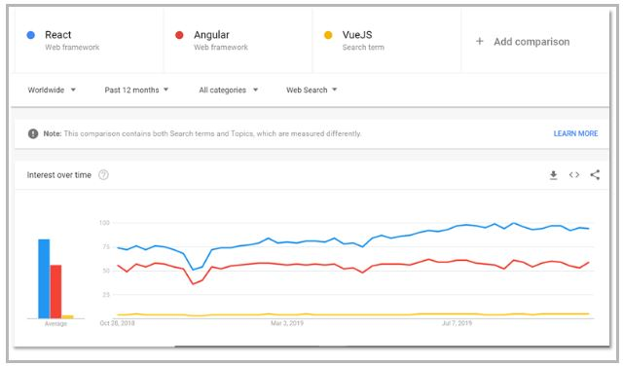
Growth Curve According to Google trends, React is on a much faster upward trajectory than Angular and Vue

Slide 38
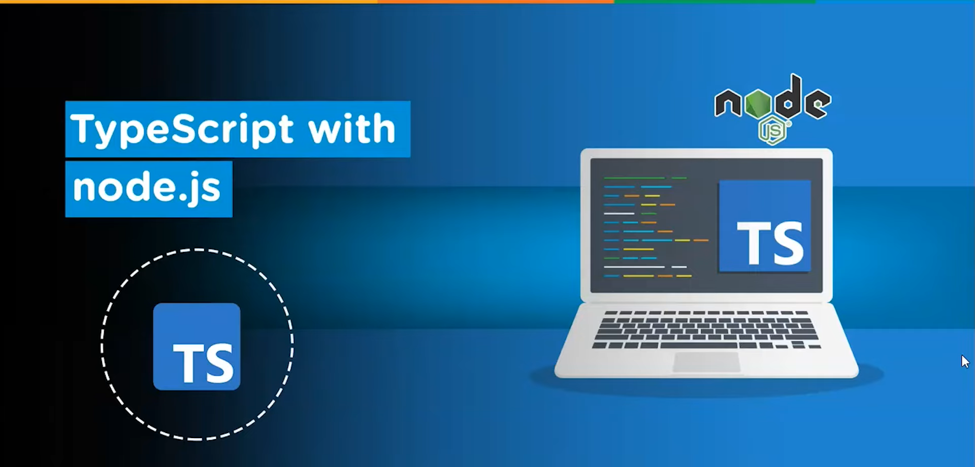

Slide 39
TypeScript
TypeScript is a superset of JavaScript and is an object-oriented and tightly typed programming language.
TypeScript code is transformed to JavaScript, which may be used in any environment that supports JavaScript, including browsers, Node.js, and your own applications.
At Microsoft, Anders Hejlsberg created typeScript.

Slide 40
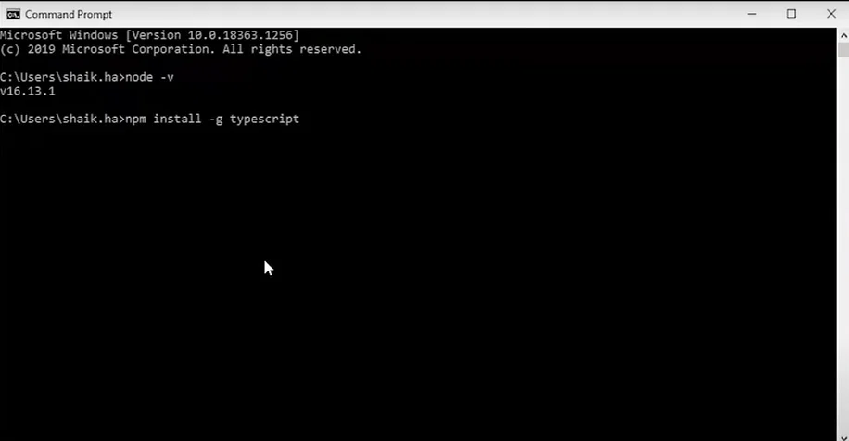
Setting Up Development Environment

Slide 41
Setting Up Development Environment
To see if the compiler is installed, type tsc —version.
Open Visual Studio Code and Run a simple program to check

Slide 42
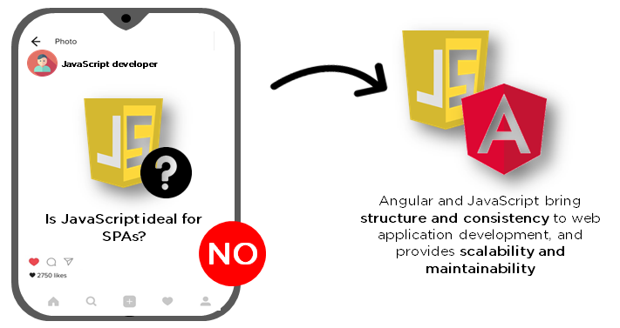
Angular

Slide 43
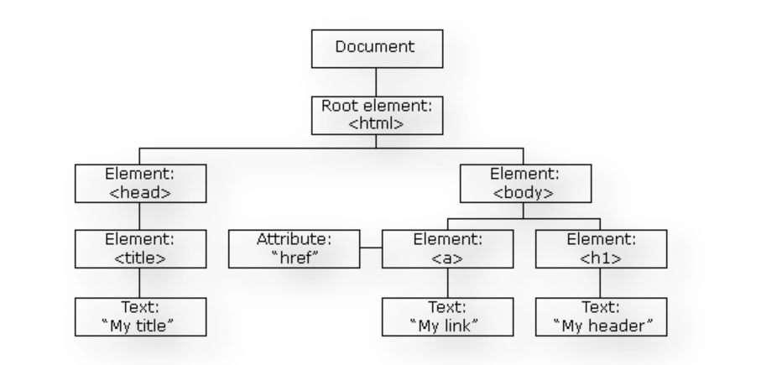
Features of Angular 1.Document Object Model

Slide 44


Typescript
Data Binding
Testing

Slide 45
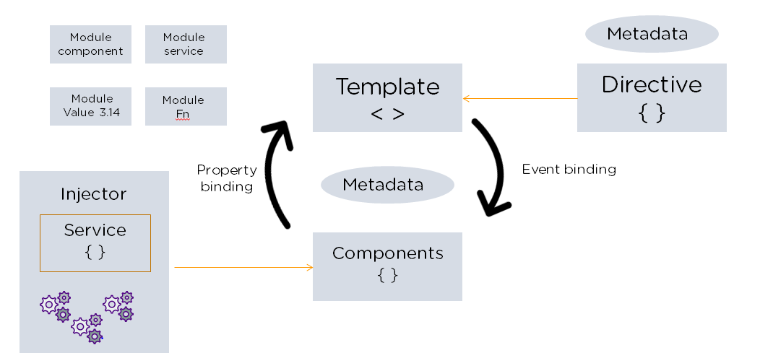
Angular Architecture Model View Controller (MVC)

Slide 46
AngularJS Directives
ng-model
ng-bind
ngFor
ngClass
ngStyle

Slide 47
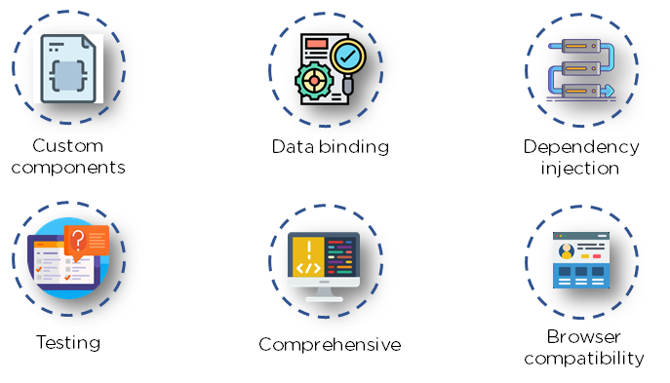
Advantages of Angular

Slide 48
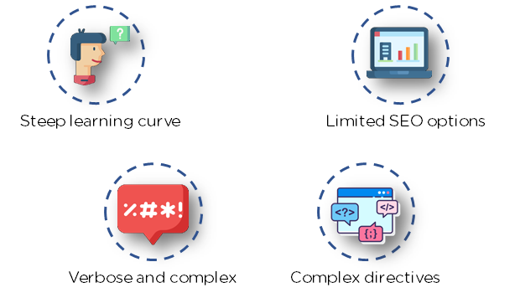
Limitations of Angular

Slide 49

Companies Using Angular

Slide 50
Creating Your First Angular Application
Angular Prerequisites
Node JS
Angular Cli
Text Editor – VS Code
ng create appname
cd appname
ng serve

Slide 51
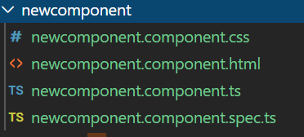
Angular Components
Creating Your First Angular Component
ng g c component-name
Component Decorator Metadata

Slide 52

Angular Data Binding
manipulate web page elements
interactive components such as forms, calculators, tutorials, and games
data to the view and vice-versa
Types
Interpolation

Slide 53


Types of Data Binding
Property Binding
uses the "[ ]" syntax for data binding
Event Binding
Two-way Data Binding

Slide 54
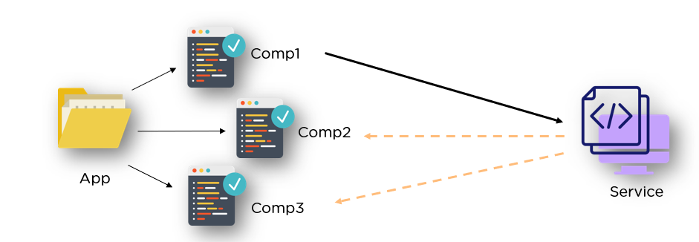
Angular Service

Slide 55
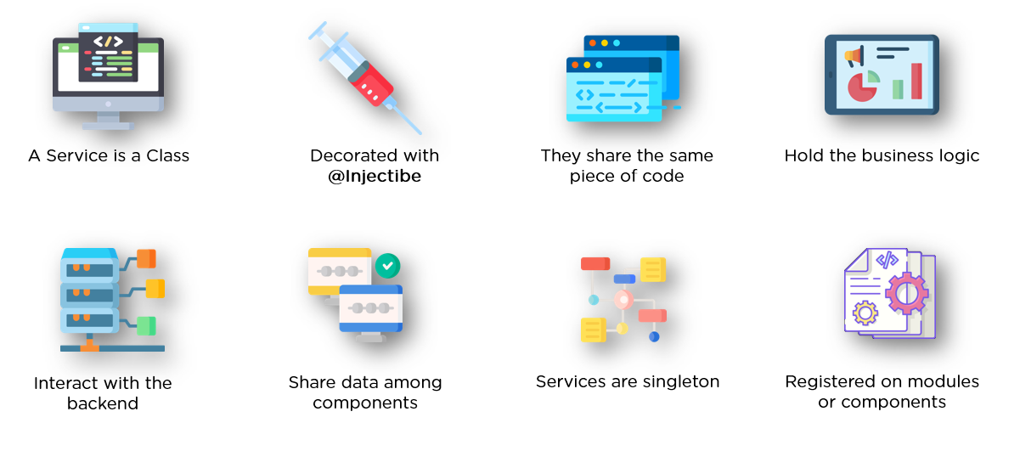
Features of Angular Service

